Slide 1
Sample Site Data Reports
For Clinic Leads

Slide 3
Methodology for Validating Expanded Testing Report for SRCHC
The data for the SRCHC Expanded Testing Reports will use the following methodology for validating the data.
Follow the reporting process here: S:\Clinics\HIV\Expanded%20HIV%20Testing\SRCHC%20ETG%20Reports\SRCHC%20ETG%20Reporting%20Process.docx
Copy and paste results into excel spreadsheet.
Make sure all blank cells are checked for any hidden data (delete any content within these cells).
Filter results to eliminate data entry errors and erroneous results.
Organize by site in a Pivot Table, using
Rows: PCP’s Facility, Patient PCP
Values: 2_LastTestWithDate&Result…, EmpPatients.AccountNo
Columns: do not populate – it will auto-populate with Row and Value choices
Click on Grand Total in the column for EmpPatients.AccountNo for each site to create a separate worksheet with all of the empaneled patients.
Organize data by Result Date to group tested and not tested together.
Use a random number generator (www.random.org) to select five patients from the group of tested, and five from the not tested.
If tested patients go from line 2 through 5000, ask the number generator to choose numbers from 2 to 5000. Make a list of the five numbers, which you can then find (by line number) in the worksheet.
Repeat previous step for untested patients. (if patients start at 5001, as the random number generator to start from there as well)
Check each record within eCW to determine accuracy of data.

Slide 10
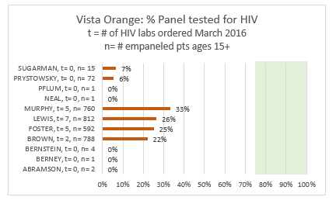

Slide 11
